Slide 1
Exploring the relationship between confidentiality and disputant participation
Dr John Woodward

Slide 2
Overview
Is NSW different? – Are we lagging behind in DR culture?
Methodology of this study.
Testing the 3 core elements of legal professional identity.
The notion of confidentiality – how does it equate to privilege?
The limits of mediation confidentiality – from Field v Commissioner for Railways (1957) 99 CLR 285 to Liu v Fairfax Media Publications [2012] NSWSC 1352.
Uncertainty in the legislation – Civil Procedure Act 2005, the Succession 2006 and beyond.
The consequences of uncertainty around mediation confidentiality.

Slide 3
The problem in NSW: Are we lagging behind?
The Civil Procedure Act, 2005 Part 2A fiasco.
The future of dispute resolution: a word from the Chief Justice of NSW (and what about the debt collectors?)

Slide 4
Methodology
An empirical, qualitative study of semi structured interviews with 35 lawyers and mediators.
 | Lawyers | Mediators
Male | 15 | 3
Female | 12 | 5
City | 4 | 4
Regional | 18 | 4
Rural | 5 | 0
Table 1. Gender and geographic distribution of respondents

Slide 5
Table 2 Distribution of respondent lawyer sample by work mix and geographic location
 | City | Regional | Rural
Family Law |  | 6 | 3
Personal Injury |  | 1
Estate Litigation |  | 4
Commercial Litigation | 1 | 4 | 1
Insurance Litigation |  | 1
Banking and finance | 3
General Practice |  | 2 | 1
TOTALS | 4 | 18 | 5

Slide 6
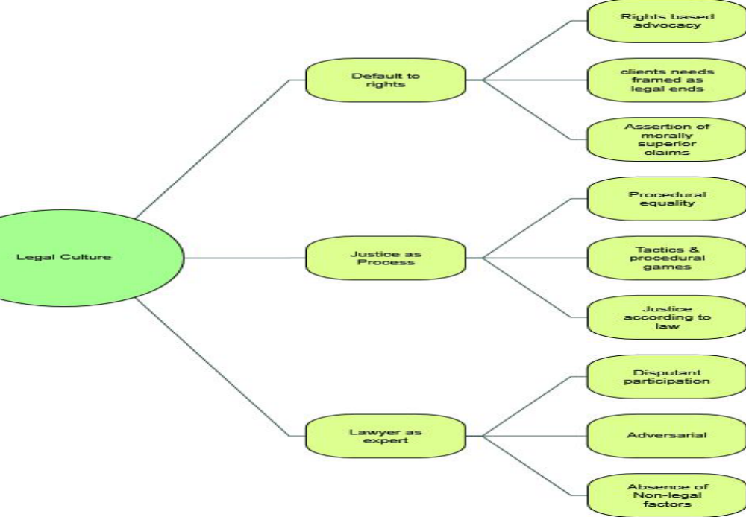
Three core elements of legal professional identity

Slide 7
The notion of “confidentiality”
A “defining element” of mediation (Boulle);
The reason why some disputants choose mediation rather than “airing their dirty linen” in the public forum of the court;
Confidentiality requires protection from both disclosure and misuse (eg commercially sensitive information, preservation of relationships etc)
Eastern culture preference to resolve disputes quietly within the family and local community;
Western idea of “settlement privilege” to facilitate open discussion to settle court cases.

Slide 8
Confidentiality is more than privilege
Settlement Privilege is protected by section 131 of the Evidence Act 1995 (NSW) and section 30 of the Civil Procedure Act 2005 (NSW)
Common law privilege has been explained by the Court as follows:
“It is of the essence of successful mediation that parties should be able to reveal all relevant matters without an apprehension that the disclosure may subsequently be used against them. As well, were the position otherwise, unscrupulous parties could use and abuse the mediation process by treating it as a gigantic, penalty free discovery process.”
AWA Limited v George Richard Daniels (1992) 7 ACSR 463 at 468 Rogers CJ Comm D.

Slide 9
The Limits of Mediation Confidentiality
Civil Procedure Act, 2005 (NSW) and Evidence Act 1995 (NSW) protect settlement privilege. They do not protect confidentiality.
Confidentiality provisions contained in s 31 of Civil Procedure Act apply only to mediators, not to parties or their lawyers.
There are no other confidentiality protections contained in CP Act.
Contractual provisions between mediators and parties requiring confidentiality to not protect court-annexed mediations where there is no contract between the mediator and parties (eg Family Provisions mediations in Supreme Court of NSW).

Slide 10
Consequences of uncertainty around limits of mediation confidentiality
Lawyers advise clients to be careful what they say in mediation, not so say anything unless they “run it by” counsel beforehand, to speak “only if you’re spoken to” or to say nothing at all.

Slide 11
Uncertainty around confidentiality leads to reduction of disputant participation
Research question: “When attending an ADR event, do you have a practice regarding the level of your client’s involvement in the process: that is, do you prefer to speak on behalf of the client or do you prefer to have the client speak during the process?”

Slide 12
The research evidence
“It tends to be that either I, or if counsel is involved, counsel, opens and I think that is generally safer but there are instances where the client is sufficiently switched on and intelligent and eloquent and confident enough to open and is not going to end up doing more harm than good but…it tends to be the exception rather than the rule. I cannot think of an instance where the client has spoken…”

Slide 13
The evidence (cont.)
“Mostly our clients don’t speak. We have said to them that they are more than welcome to but if you’re going to get emotional or hysterical then our preference would be don’t. Mostly the clients don’t. They choose not to.”

Slide 14
The evidence (cont.)
“…I think that they might blurt something out without thinking so I would encourage them to go into one of the breakout rooms and discuss it…”
Q. Alright I just want to take you back to something you said about ‘blurting out’ something in the mediation. Is that a concern for you that someone would do that?
A. Yes.
Q. Why is that a concern?
A. Just because the clients have engaged their lawyers for a reason so they might say something that would be prejudicial to their case without realising it and they might say something that is privileged and even though I understand that mediation is not allowed to be used in court, I still think it is best if they be advised against giving away anything because it could assist the other side to subpoena them for something or to send them a notice to produce about information or a document that they might not otherwise have known about.”

Slide 15
The evidence (cont.)
“No, I like to do the talking or let counsel do the talking. I use the ‘speak if you’re spoken to’ approach. And I justify that on the basis of, you know, you could get yourself into trouble. You could give away something that you really don’t want to give away.”

Slide 16
The evidence (cont.)
“No, I don’t think it is a good idea for the client to be doing the talking. No, not at all. It’s for the professionals. It’s a much more subtle process – the whole negotiation and the whole process. A client could sour the whole thing so quickly. Forty years of legal experience allows me to be involved in the process.”

Slide 17
Conclusions from the evidence?
Reasons for discouraging disputant participation are concerns around “giving away” or “blurting out” something which is confidential;
Desire to protect confidential information from misuse.

Slide 18
Other incidental outcomes
Helps to preserve the balance of power in favour of the lawyer (Macfarlane’s third core element of legal professional identity);
Sustains the belief in the lawyer as expert in the DR process;
Inhibits the free flow of information between the parties and reduces the likelihood of parties being able to work together to reach consensus.

Slide 19
Rosenthal’s Research
Result | Active Client | Passive Client
Good | 75% | 41%
 | (21) | (12) | N = 33
Poor | 25% | 59%
 | (7) | (17) | N = 24
 | N = 28 | N = 29 | N = 57
Table 3: Client Participation Related to Case Result

Slide 20
The effect of affect – Carnevale and Ison Research
Inducing positive affect produces positive outcomes;
Inducing negative affect produces negative outcomes.

Slide 21
Conclusion
The dilemma of court-connected mediation, the site where mediation collides with the traditional justice institutions, has not yet been resolved. The competing public interests in settlement privilege and confidentiality on one hand and the admissibility of all relevant evidence on the other have yet to be reconciled.

Slide 22
The End
Questions?

